Slide 1
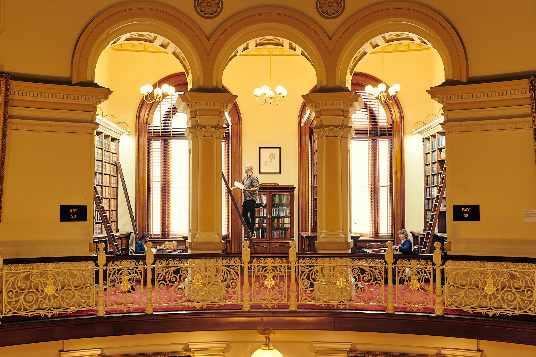
A regulator's data story Presented by Kerri-anne Millard Director – Policy & Outreach Victorian Legal Services Board + Commissioner

Slide 2
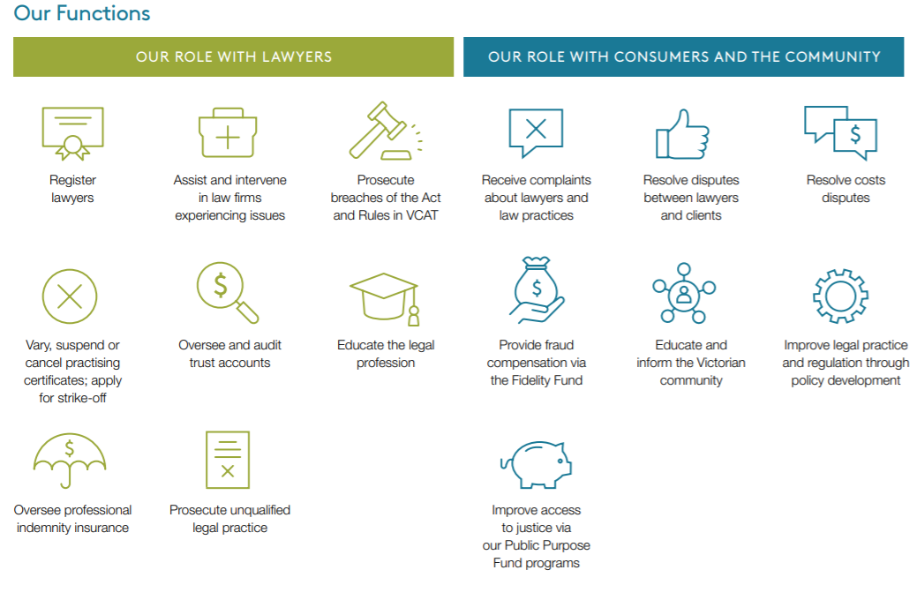
Our current sources of data

Slide 3
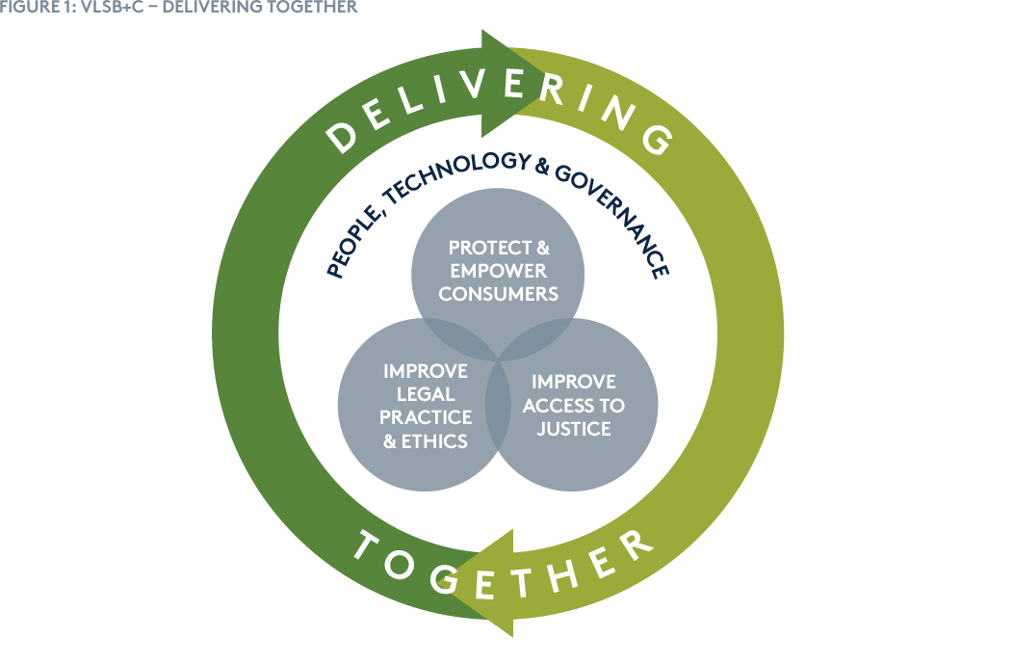
Data Strategy supports Organisational Strategy
Why we exist: To maintain public trust and confidence in lawyers
Strategic objectives:

Slide 4
Data Strategy supporting Organisational Strategy
Challenges
Objectives
Data Strategy: Lack of holistic data strategy aligned with the corporate plan.
Data Quality: Data quality issues underpinned by incomplete information, manual processes, ambiguous and duplicate data.
Data Governance: Lack of data governance to control and effectively manage the VLSB+C’s data assets with well-defined data ownership, policies, standards and practices.
Data Insights and Analytics: Ad-hoc analytical reporting and insights.
Data Infrastructure: Lack of advanced analytical tools to harness the value of the data assets for decision making.
Data Culture and Capability: Low level of data culture and analytical capability hinders creation of value through data analytics.
Data sharing and asset management: Ad-hoc data sharing and asset management impede continuous generation of relevant data and analytics to solve regulatory challenges.
Establish and apply corporate-wide data governance policies, standards and practices to improve quality of data and ensure secure and accessible data use.
Accelerate data-driven insights for decision making to achieve policy outcomes.
Build advanced analytics processes and infrastructure to support data-driven decision making.
Nurture data culture and strengthen data capability to achieve operational excellence.
Optimise and source more relevant data through data sharing arrangements and data asset management

Slide 5
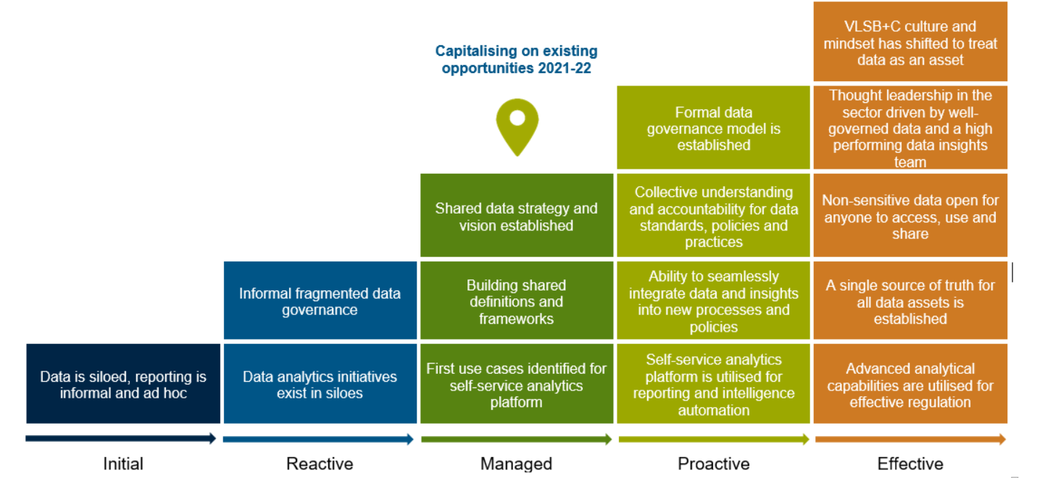
Where we are and where we want to go

Slide 6
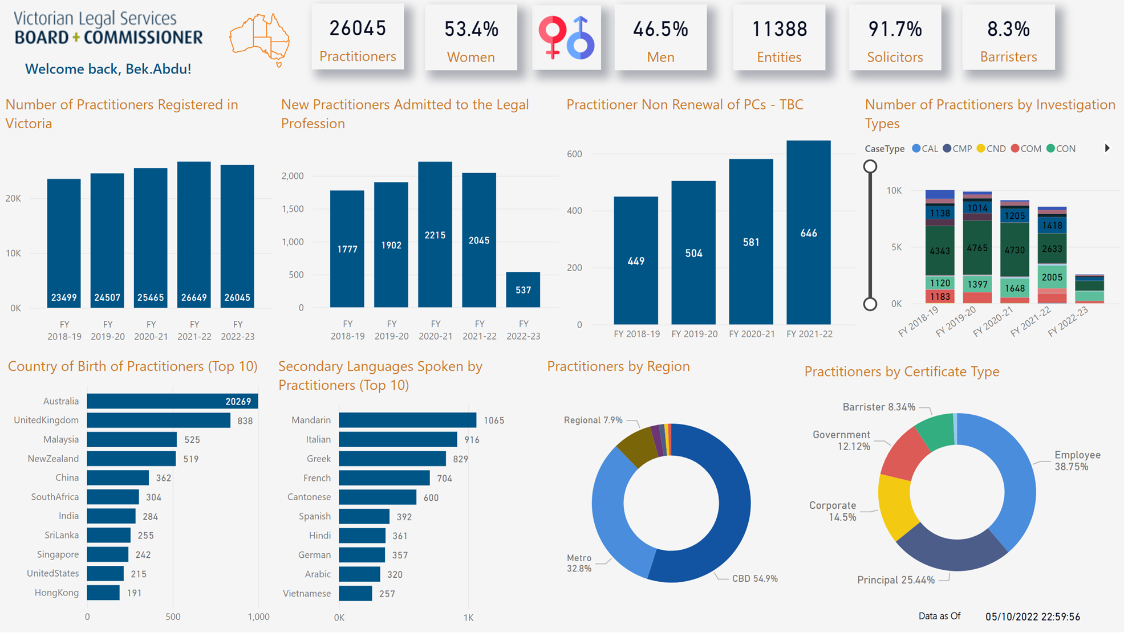
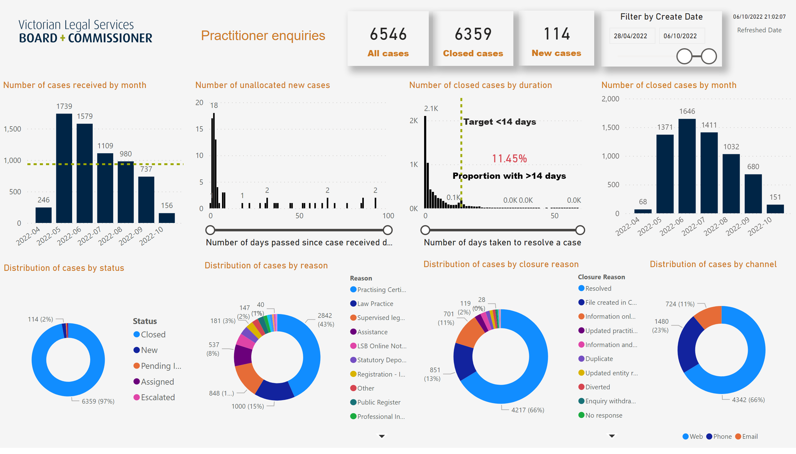
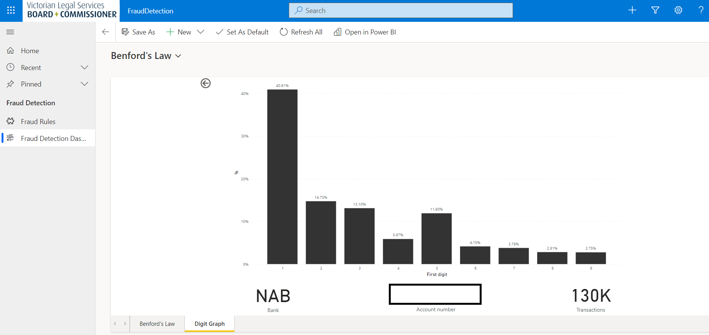
Our data ecosystem today and examples
DATA STRATEGY
Self-service analytics
ADVANCED
ANALYTICS
DATA
CAPABILITY
DATA
INFRASTRUCTURE
Fraud detection (e.g. Benford’s law)
DATA
APPLICATIONS
SELF-SERVICE
ANALYTICS

